Slide 1
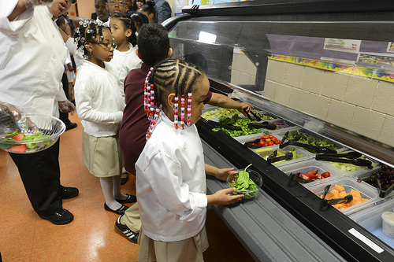

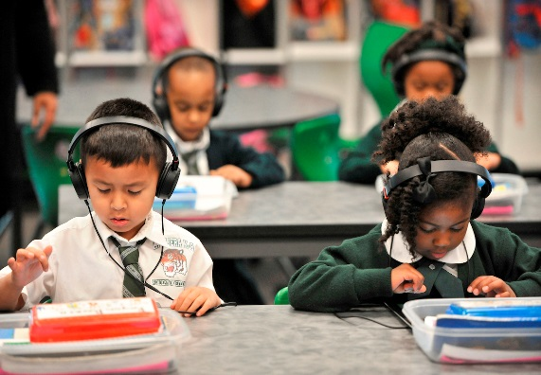


You can be part of something
BIG IN INGLEWOOD
https://www.governmentjobs.com/careers/inglewoodusd
PHOTO
PHOTO
PHOTO
Available Positions:
FOOD SERVICE ASSISTANT I, II, III AND FOOD SERVICE ASSISTANT III (HIGH SCHOOL),
INSTRUCTIONAL AIDE I-ASES, INSTRUCTIONAL AIDE I – PRESCHOOL,
INSTRUCTIONAL ASSISTANT – SPECIAL NEEDS
Date: FRIDAY, SEPTEMBE 27, 2019 Questions:
Time: 9:00A.M. – 4:00P.M. Melissa Railey
Location: INGLEWOOD UNIFIED SCHOOL DISTRICT Phone: (310) 419-2761
401 S. INGLEWOOD AVE, INGLEWOOD CA 90301 E-Mail: Melissa.railey@inglewoodusd.com
On-the-Spot Interviews
To expedite hiring process please bring the following documents:
TB Results, Valid ID, and Social Security CARD
FOOD SERVICES DEPARTMENT (Hours Vary From 3 Hrs. to 7.0 Hrs. Per Day)
Under direction of an assigned supervisor, assist in the preparation and serving of food at an assigned food service facility; maintain food service facilities in a clean and sanitary condition; Serve meals, beverages and snacks
INSTRUCTIONAL AIDE POSITIONS (Hours Vary From 3 Hrs. to 6 .0 Hrs. Per Day)
Assist teachers in providing and reinforcing instruction to individuals or small groups of students in as assigned learning environment; prepare instructional materials and perform clerical duties in support of classroom activities.
.

